Slide 1
301 Sep 29, Class 6
Experiment 1 background
Levels of Processing theory
  Prior research

Slide 2
Craik & Lockhart (1972): Depth of processing
Memory background
  Somewhat archaic terms (STS, LTS)
  Modern framework has similar structure (Multistore)
    Working memory (from perception): capacity-limited, rapidly fading
    Long-term memory: large capacity, highly persistent
  LTM is all stored knowledge
    Knowledge of general facts = Semantic
    Knowledge of personal experiences = Episodic
Semantic memory includes knowing what a word means
Episodic memory refers to the event of encountering that word during the study phase

Slide 3
CL1972 HW Questions
1. What is 'depth of processing' and why might it lead to better memory?
2. In our study, what was the operational definition of 'deep encoding'?
3 In our study, what was the operational definition of 'shallow encoding'?

Slide 4
CL1972 HW Questions
4. From the prior work cited (e.g., p 677), give another example of how researchers have implemented a different procedure to create shallow encoding.
5. Give another example of deep encoding from the briefly reviewed prior work.

Slide 5
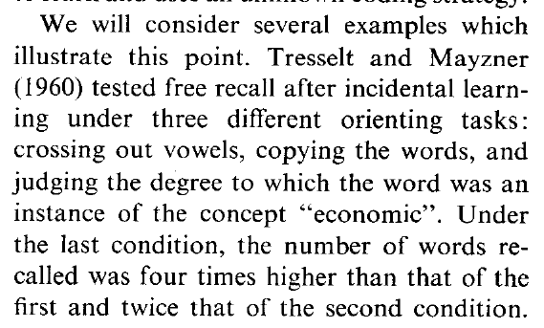
Prior work
Brief summaries of prior work in which study conditions included procedures similar to those used in depth of processing
These operational definitions arose from different constructs

Slide 6
Incidental learning
Contrasted with intentional learning
Was our Experiment 1 incidental or intentional learning?
  How does this affect the conclusions we will draw?

Slide 7
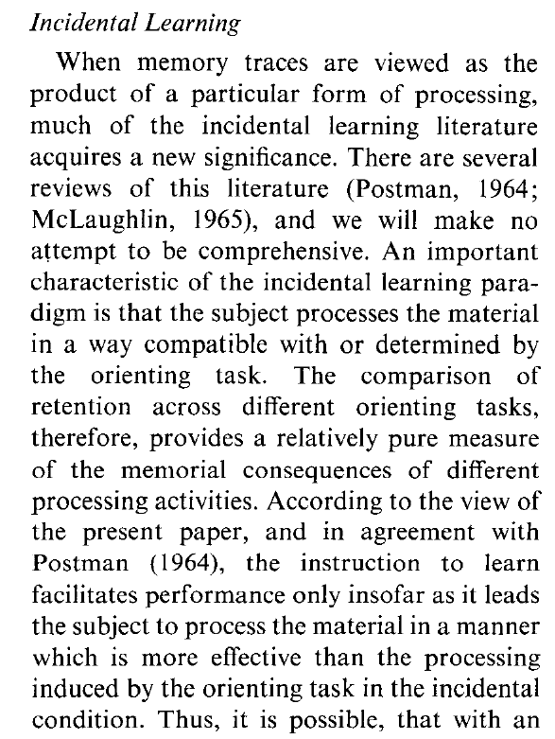

Slide 8
Craik & Tulving (1975)
10 experiments
Multiple replications
  Value of different approaches to IV and DV
Writing and presentation, methodological detail, results
  This is an older variant of APA style
  Your report should be in modern style

Slide 9
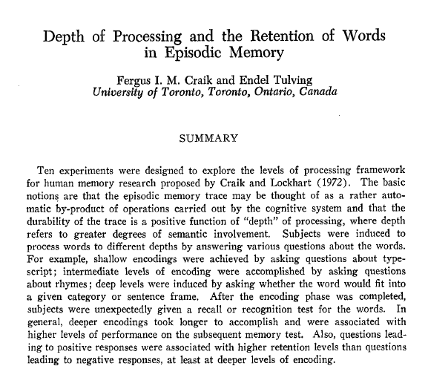

Slide 10
Q1
In Experiment 1, how many levels of the IV were used?
What was the DV measure of memory?

Slide 11
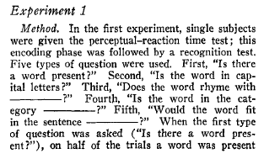
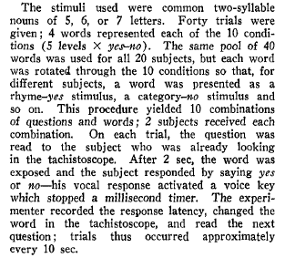
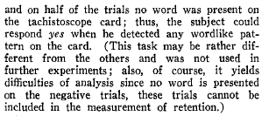
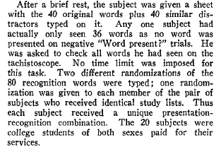
Exp 1 Methods
Materials
Procedure

Slide 12
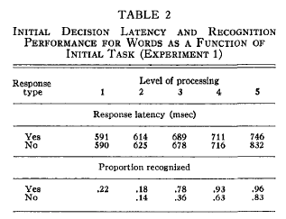
Exp 1 Results

Slide 13
Q2
Experiment 5 is carefully designed to address what confounding alternative hypothesis?
To do so, what aspect of the IV is made as constant as possible?

Slide 14
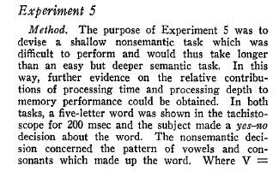
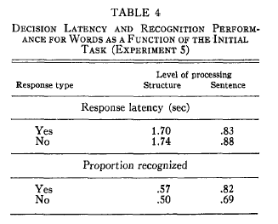
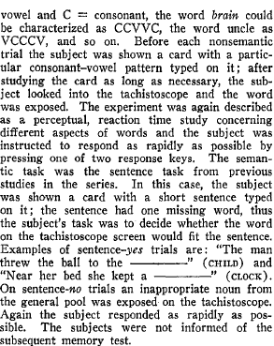

Slide 15
Q3
In what way was Experiment 9 similar to our in-class experiment?
Identify some methodological differences

Slide 16
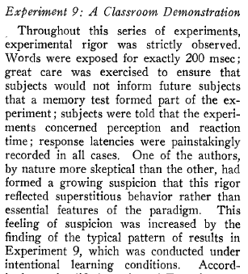
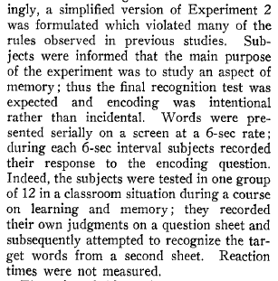
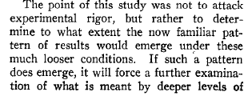

Rational for classroom study

Slide 17
For Wed
Chapter 6
  Statistics 1
Operations Manual, Experiment 1 t-test
  Using Excel to calculate descriptive statistics
  Using R to run the t-test
    Scripts provided
  Using Excel to make a figure
    Online version does not have the error bar feature we need

